Slide 1
SPOTIFY PLAYLIST AUDIO FEATURES EDA
TOM ALEX
DHRUV PATEL
SANDEEP UNNIKRISHNAN

Slide 2
Problem / Hypothesis
What features make a desirable track for Tom?
What features make an undesirable track for Tom?
If we use Spotify’s API to retrieve track attributes along with visualization libraries to process the data, we will find that Tom likes tracks that are fast-paced and loud.

Slide 3
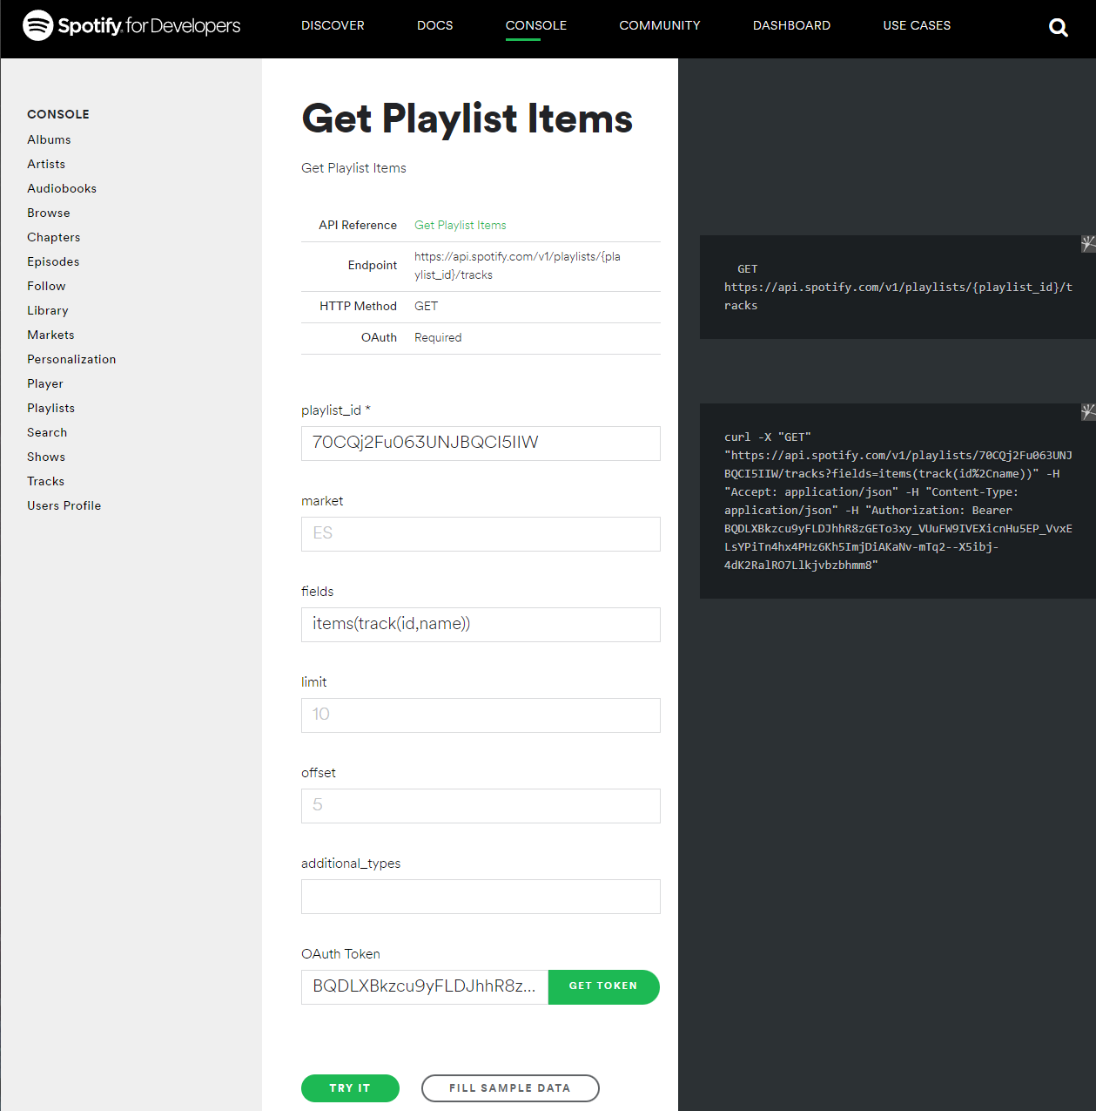
DATA COLLECTION - SPOTIFY API
Two playlists totalling 700+ songs
liked tracks “YES PLAYLIST”
disliked tracks “NO PLAYLIST”
Retrieve playlist IDs
Retrieve Authorization Token
Enter Playlist IDs and Authorization Token
Retrieve Track IDs in playlists

Slide 4
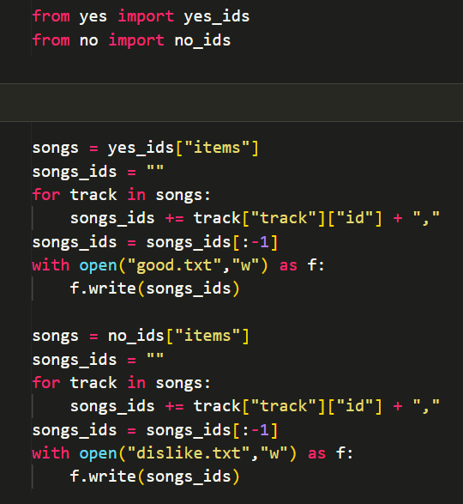
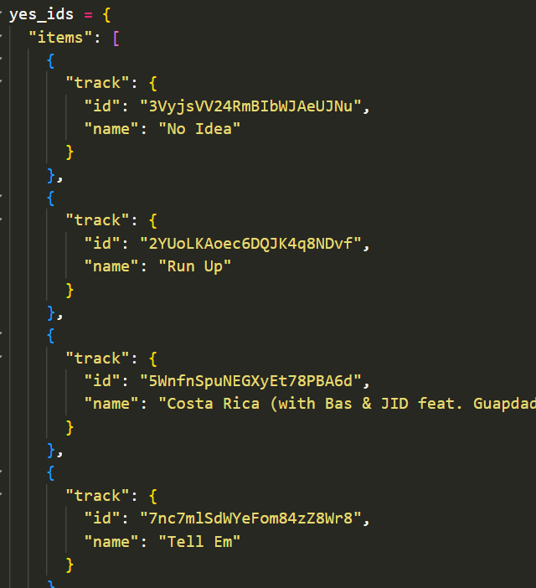
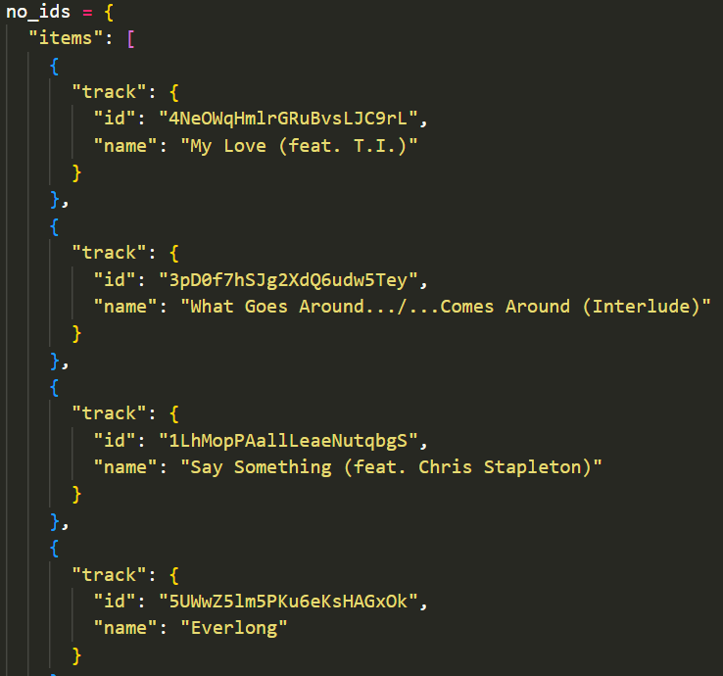
DATA COLLECTION - SPOTIFY API (cont.)
Retrieve track ids from generated data

Slide 5
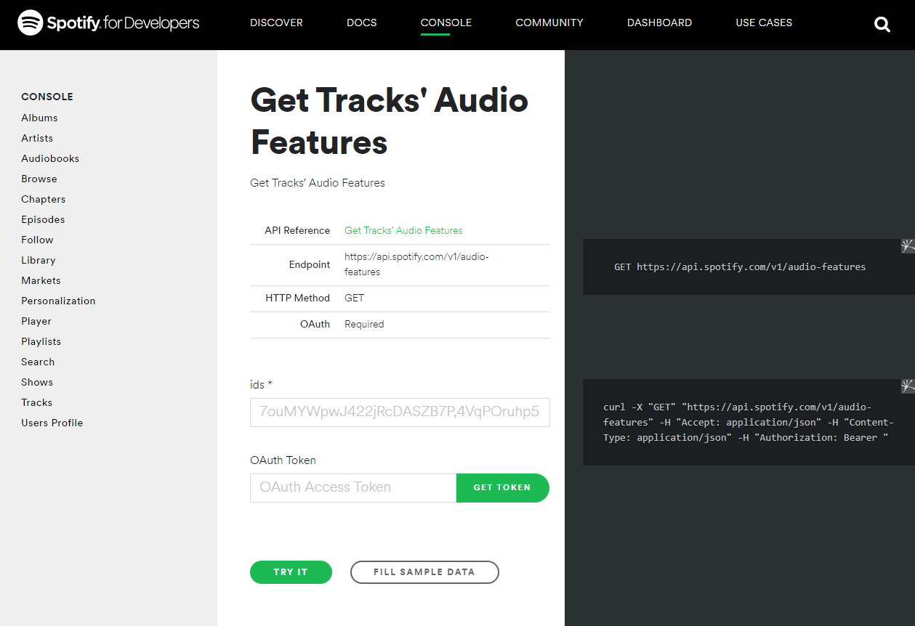
DATA COLLECTION - SPOTIFY API (cont.)
Enter string of trackIDs separated by commas for each playlist
Enter Authorization Token
Save output as .json

Slide 6
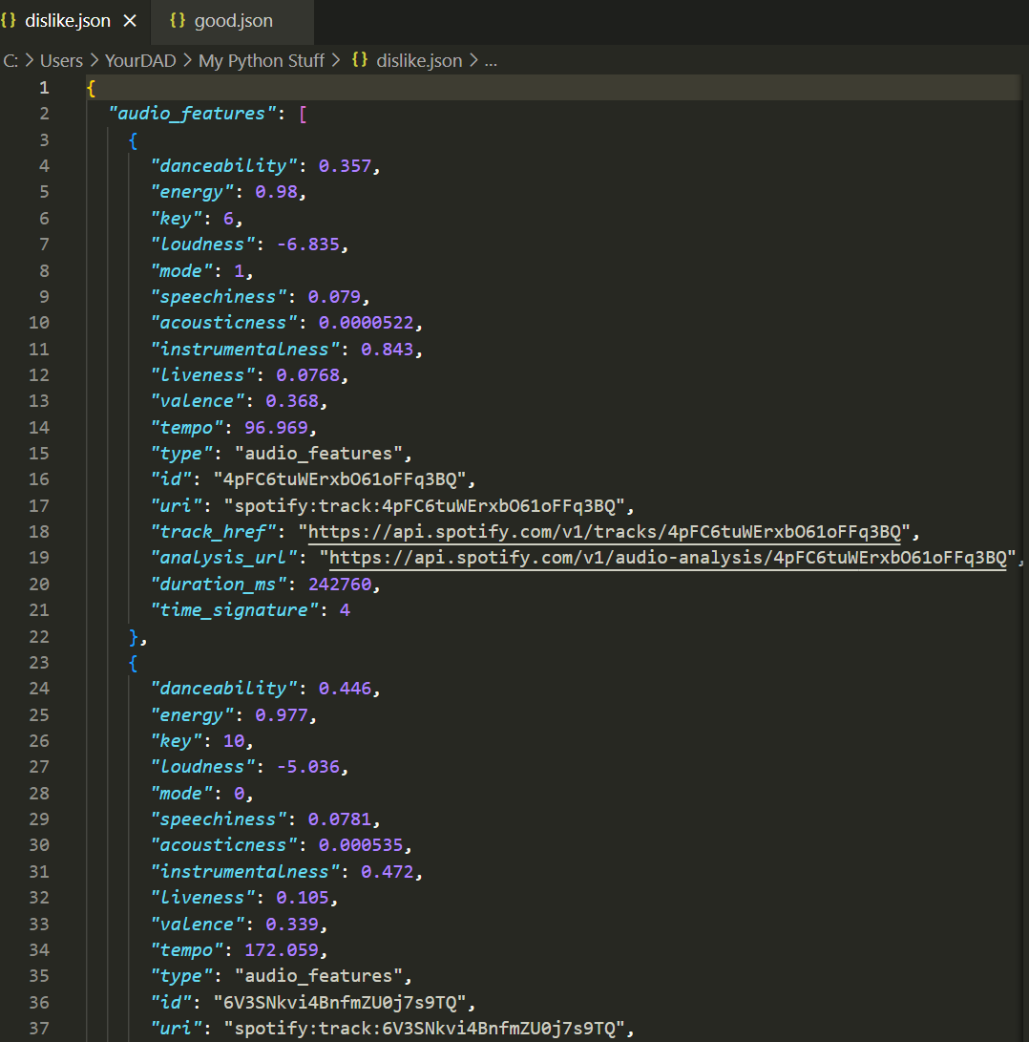
DATA COLLECTION - SPOTIFY API (cont.)
We manipulate the data from these .json files:
good.json
dislike.json

Slide 7
Spotify API Documentation
Acousticness : A confidence measure from 0.0 to 1.0 of whether the track is acoustic. 1.0 represents high confidence the track is acoustic.
Danceability : Danceability describes how suitable a track is for dancing based on a combination of musical elements including tempo, rhythm stability, beat strength, and overall regularity. A value of 0.0 is least danceable and 1.0 is most danceable.
Duration_ms : The duration of the track in milliseconds.
Energy : Energy is a measure from 0.0 to 1.0 and represents a perceptual measure of intensity and activity. Typically, energetic tracks feel fast, loud, and noisy. For example, death metal has high energy, while a Bach prelude scores low on the scale. Perceptual features contributing to this attribute include dynamic range, perceived loudness, timbre, onset rate, and general entropy.
Instrumentalness : Predicts whether a track contains no vocals. “Ooh” and “aah” sounds are treated as instrumental in this context. Rap or spoken word tracks are clearly “vocal”. The closer the instrumentalness value is to 1.0, the greater likelihood the track contains no vocal content. Values above 0.5 are intended to represent instrumental tracks, but confidence is higher as the value approaches 1.0.
Key : The key the track is in. Integers map to pitches using standard Pitch Class notation . E.g. 0 = C, 1 = C♯/D♭, 2 = D, and so on.
Liveness : Detects the presence of an audience in the recording. Higher liveness values represent an increased probability that the track was performed live. A value above 0.8 provides strong likelihood that the track is live.
Loudness : The overall loudness of a track in decibels (dB). Loudness values are averaged across the entire track and are useful for comparing relative loudness of tracks. Loudness is the quality of a sound that is the primary psychological correlate of physical strength (amplitude). Values typical range between -60 and 0 db.
Mode : Mode indicates the modality (major or minor) of a track, the type of scale from which its melodic content is derived. Major is represented by 1 and minor is 0.
Speechiness : Speechiness detects the presence of spoken words in a track. The more exclusively speech-like the recording (e.g. talk show, audio book, poetry), the closer to 1.0 the attribute value. Values above 0.66 describe tracks that are probably made entirely of spoken words. Values between 0.33 and 0.66 describe tracks that may contain both music and speech, either in sections or layered, including such cases as rap music. Values below 0.33 most likely represent music and other non-speech-like tracks.
Tempo : The overall estimated tempo of a track in beats per minute (BPM). In musical terminology, tempo is the speed or pace of a given piece and derives directly from the average beat duration.
Time_signature : An estimated overall time signature of a track. The time signature (meter) is a notational convention to specify how many beats are in each bar (or measure).
Valence : A measure from 0.0 to 1.0 describing the musical positiveness conveyed by a track. Tracks with high valence sound more positive (e.g. happy, cheerful, euphoric), while tracks with low valence sound more negative (e.g. sad, depressed, angry).

Slide 8
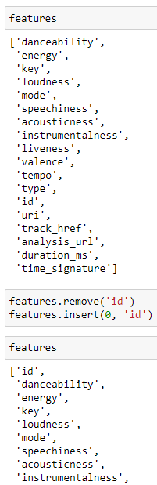
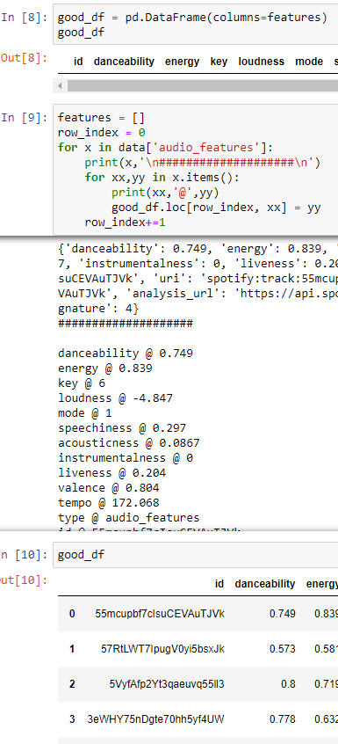
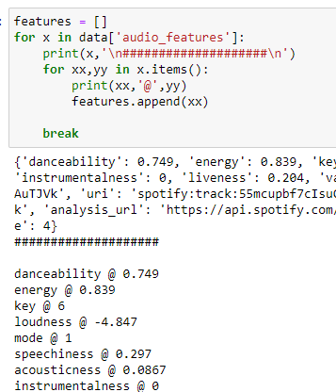
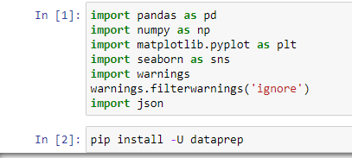
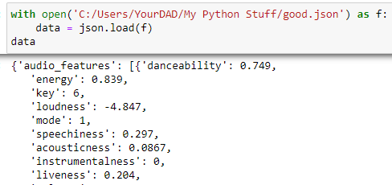
Data Cleaning / Data Prep
Imported Libraries:
Open/Load JSON files
Did the same for dislike.json

Slide 9
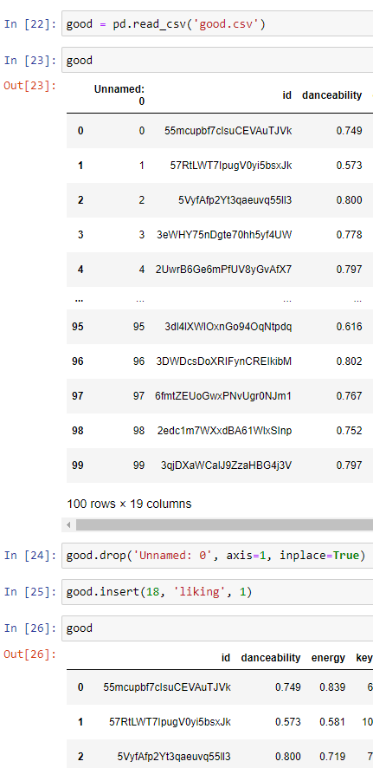
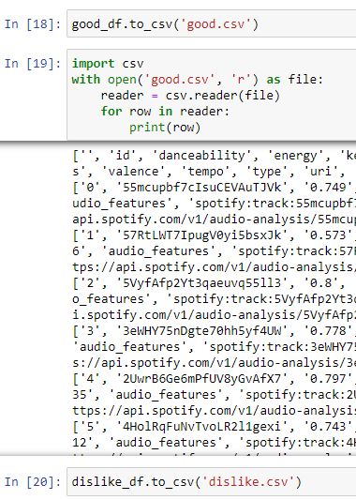
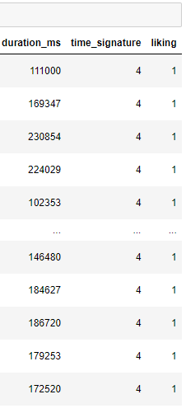
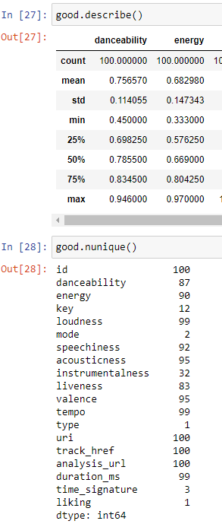
Data Cleaning (cont.)
Did the same for dislike
Convert DF to CSV
Unique Values

Slide 10

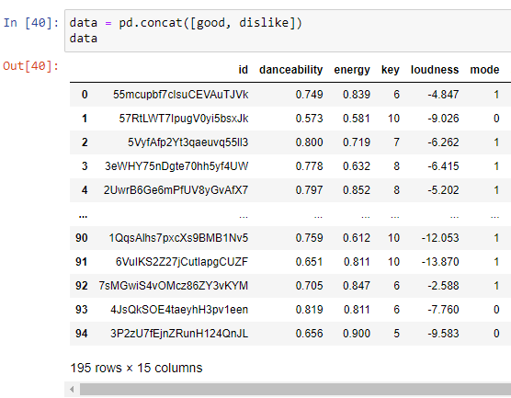
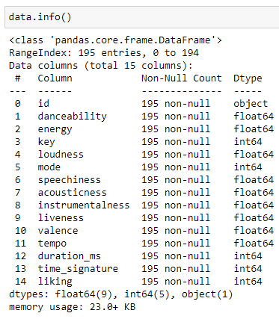
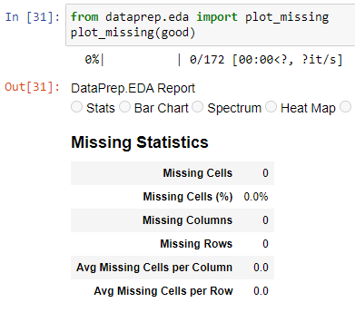
Data Cleaning / Data Prep (cont.)
Drop Columns
Merge DFs
Find Missing Cells
Did the same for dislike

Slide 11
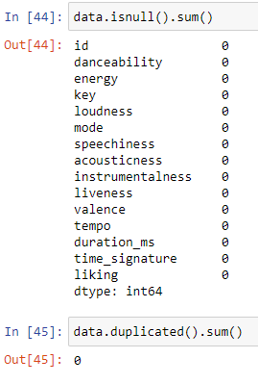
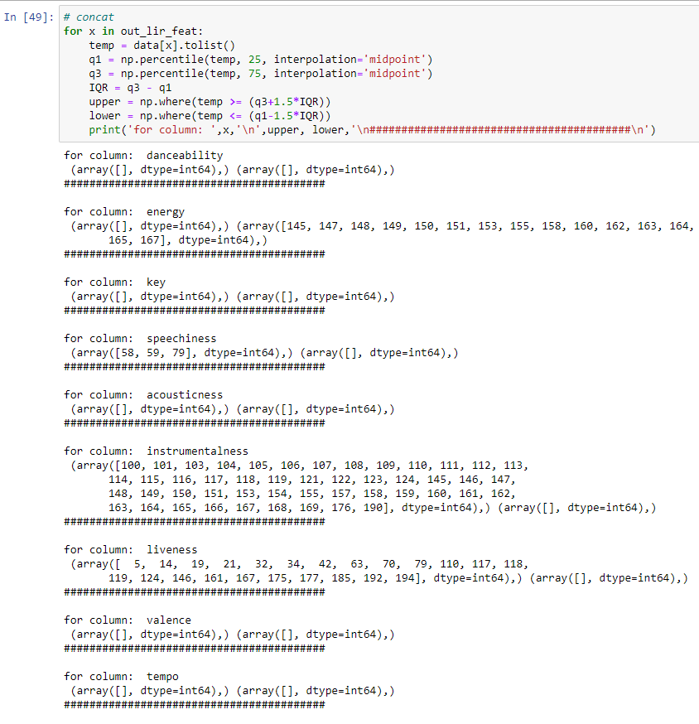
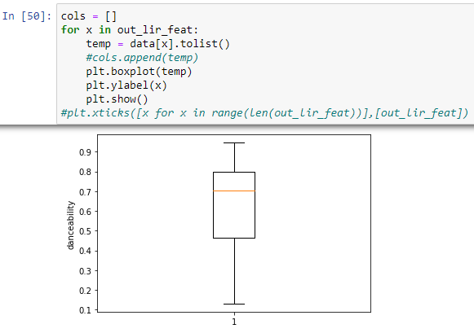
Data Cleaning (cont.)
Find Null and Duplicated Values
Checking For Outliers

Slide 12
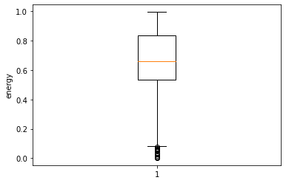
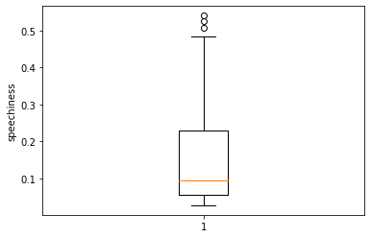
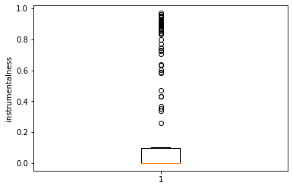
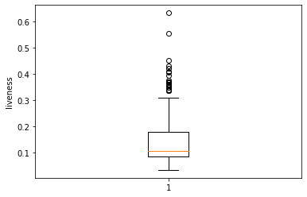
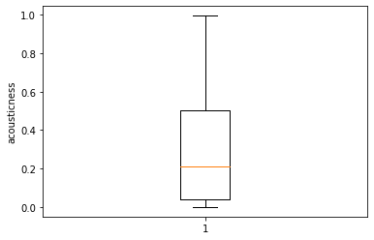
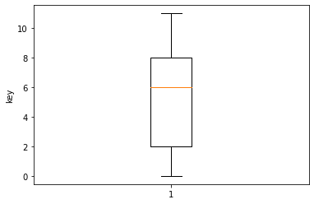
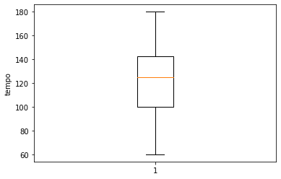

Outliers
No outliers were removed as it defines the extreme forwardness of the song towards that audio feature

Slide 13
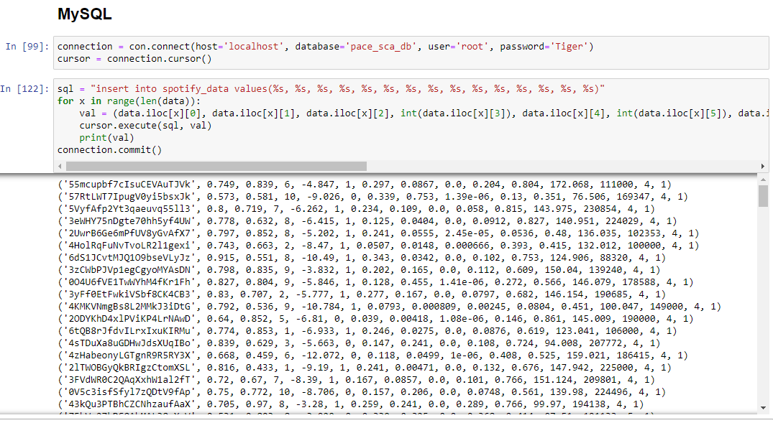
Saving Data to MySQL

Slide 14
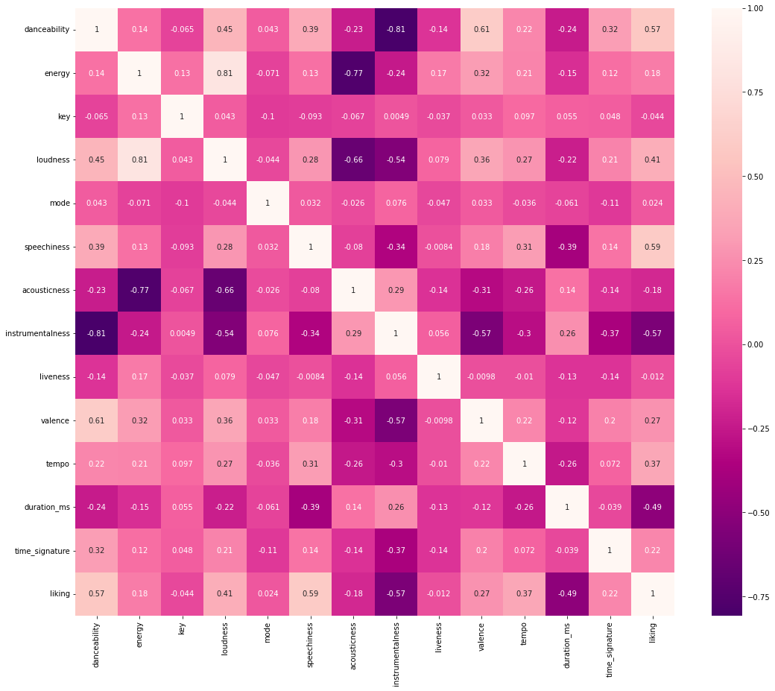
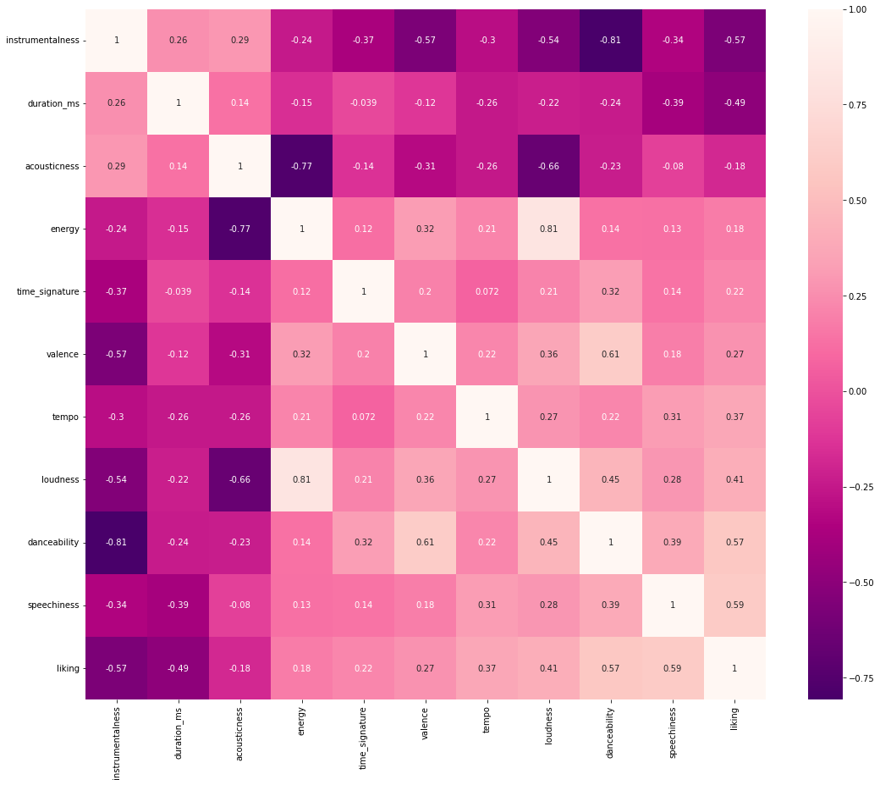
Heat Map
Correlated
Highly-Correlated

Slide 15
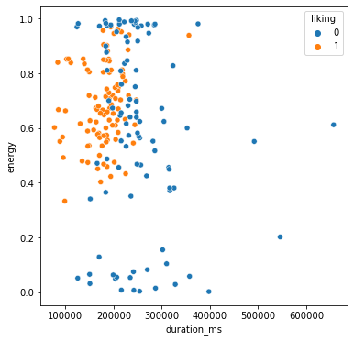
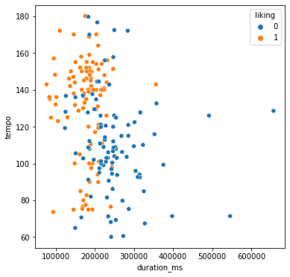
Scatter Plots
duration_ms x energy
duration_ms x tempo
right_g = ['acousticness', 'energy', 'valence', 'tempo', 'loudness', 'danceability']
for x in right_g:
scatterprint(data, 'duration_ms', x)
duration_ms x energy
Tom favors high energy (high intensity and activity) and typically shorter duration tracks
duration_ms x tempo
Tom favors high BPM tracks with varying levels of duration

Slide 16
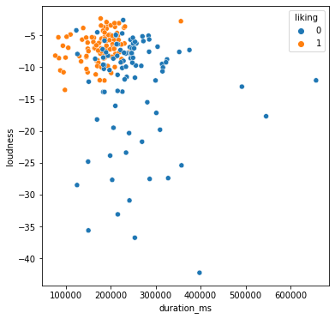
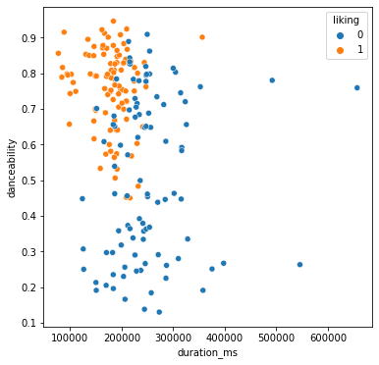
Scatter Plots (cont.)
duration_ms x loudness
duration_ms x danceability
duration_ms x loudness
Tom favors very loud tracks over anything else
duration_ms x danceability
Tom favors tracks with over 0.4 in danceability and typically shorter duration tracks

Slide 17
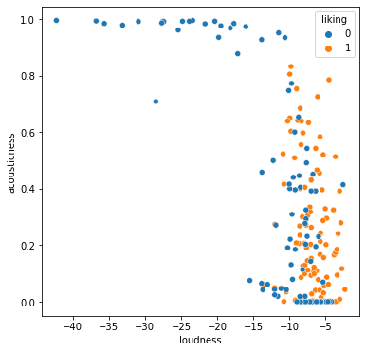
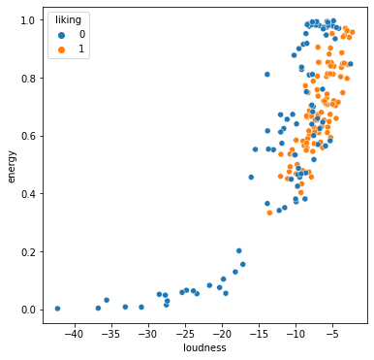
Scatter Plots (cont.)
loudness x acousticness
loudness x energy
loudness x acousticness
Tom favors loudness over acousticness
loudness x energy
Tom favors songs with high energy and loudness
right_g = ['acousticness', 'energy', 'valence', 'tempo', 'instrumentalness', 'acousticness', 'danceability']
for x in right_g:
scatterprint(data, 'loudness', x)

Slide 18
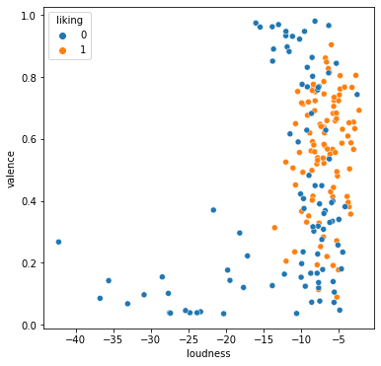
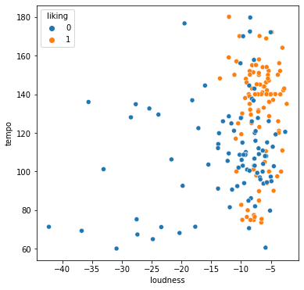
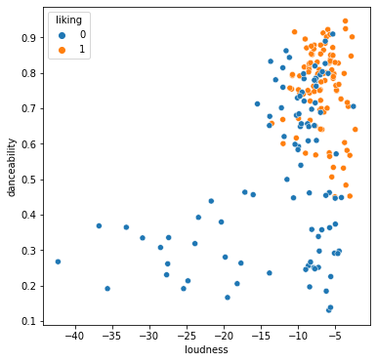
Scatter Plots (cont.)
loudness x valence
loudness x tempo
loudness x danceability
loudness x valence
Tom favors loud songs irregardless of valence (musical positiveness)
loudness x tempo
Tom favors loud songs irregardless of tempo (bpm)
loudness x danceability
Tom favors tracks that are danceable and loud

Slide 19
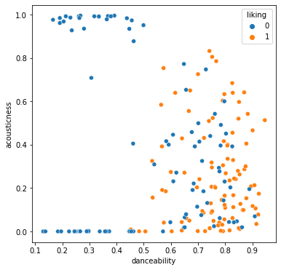
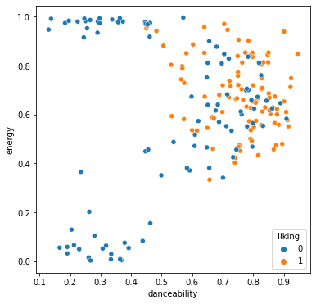
Scatter Plots (cont.)
danceability x acousticness
danceability x energy
danceability x acousticness
Tom favors danceability over acousticness
danceability x energy
Tom favors songs with high energy and danceability

Slide 20
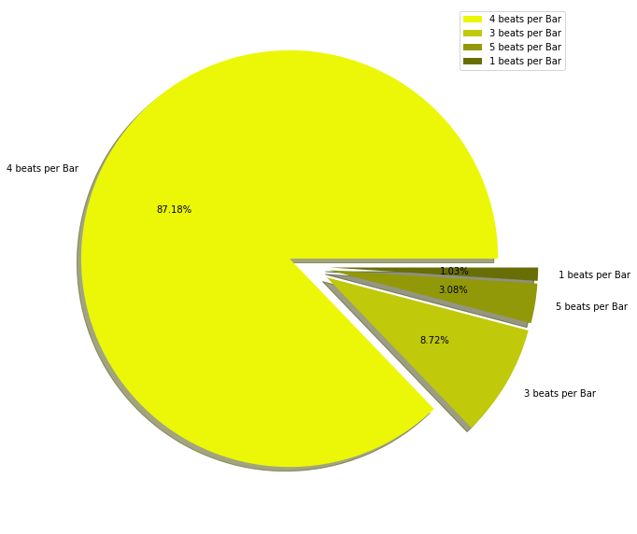
Pie Chart
Beats Per Bar
plt.figure(figsize= (10, 20))
data_pie = [170 , 17, 6, 2]
labels = ["4 beats per Bar","3 beats per Bar","5 beats per Bar","1 beats per Bar"]
explode = [0.1, 0.1, 0.1, 0.1]
plt.pie(data_pie ,labels= labels , explode = explode , autopct="%1.2f%%", shadow= True, colors= ['#ebf707','#c0c90a','#929908','#686e05'])
plt.legend()
plt.show()

Slide 21
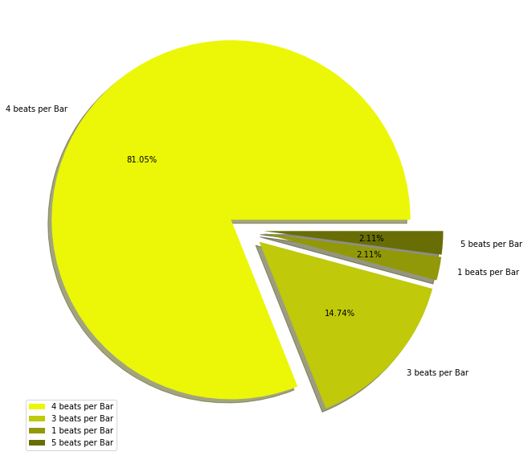
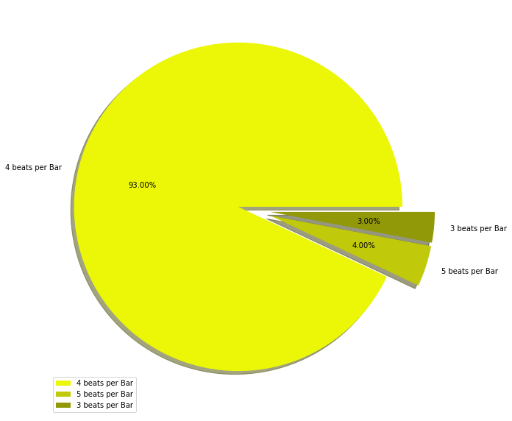
Pie Chart
Beats Per Bar
DislIked Tracks
LIked Tracks

Slide 22
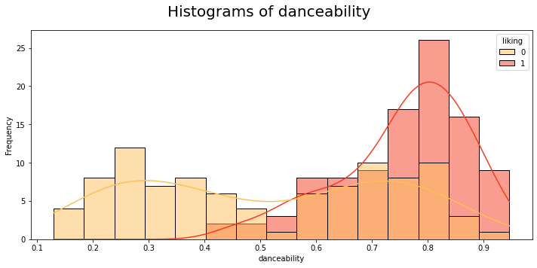
Histograms
- every liked track ranks at least 0.5 in danceability
- although a track may have high danceability, it is not necessarily liked
- disliked tracks has a bimodal shape in danceability
- liked tracks are negatively skewed(skewed left) in danceability
plt.figure(figsize=(10,5))
plt.suptitle('Histograms of danceability', fontsize = 20)
ax1 = sns.histplot(x = data['danceability'],color= 'teal', hue= data['liking'], bins= 15, kde= True, palette= 'YlOrRd')
ax1.set(xlabel= 'danceability', ylabel= 'Frequency')
plt.tight_layout()
plt.show()

Slide 23
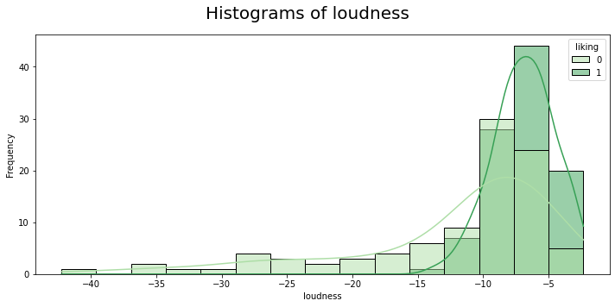
Histograms (cont.)
- every liked track ranks at least -15db in loudness
- although a track may be loud, it is not necessarily liked
- liked and disliked tracks are negatively skewed(skewed left) in loudness
plt.figure(figsize=(10,5))
plt.suptitle('Histograms of loudness', fontsize = 20)
ax1 = sns.histplot(x = data['loudness'],color= 'teal', hue= data['liking'], bins= 15, kde= True, palette= 'Greens')
ax1.set(xlabel= 'loudness', ylabel= 'Frequency')
plt.tight_layout()
plt.show()

Slide 24
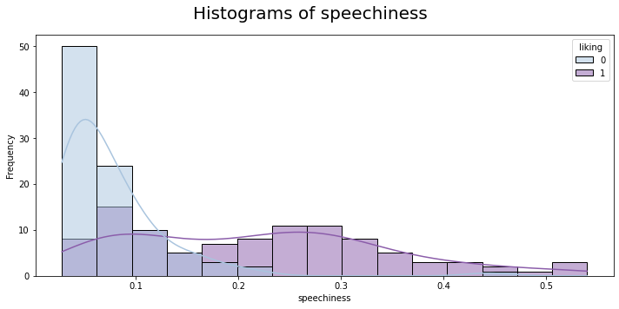
Histograms (cont.)
- liked tracks vary in speechiness, but are generally higher in speechiness compared to disliked tracks
- disliked tracks are typically low in speechiness
- disliked tracks are more positively skewed(skewed right) than liked tracks
plt.figure(figsize=(10,5))
plt.suptitle('Histograms of speechiness', fontsize = 20)
ax1 = sns.histplot(x = data['speechiness'],color= 'teal', hue= data['liking'], bins= 15, kde= True, palette= 'BuPu')
ax1.set(xlabel= 'speechiness', ylabel= 'Frequency')
plt.tight_layout()
plt.show()

Slide 25
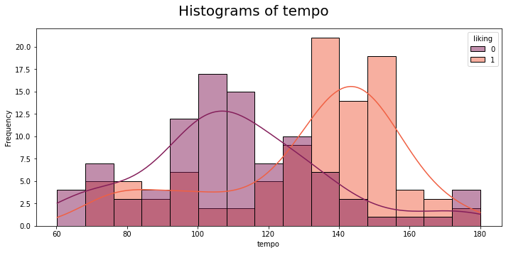
Histograms (cont.)
- liked tracks are generally high in tempo, around 150 bpm
- disliked tracks are generally lower than liked tracks in tempo around, 110 bpm
- disliked tracks are slightly positively skewed(skewed right) while liked tracks, are slighly negatively skewed
plt.figure(figsize=(10,5))
plt.suptitle('Histograms of tempo', fontsize = 20)
ax1 = sns.histplot(x = data['tempo'],color= 'yellow', hue= data['liking'], bins= 15, kde= True, palette= 'rocket')
ax1.set(xlabel= 'tempo', ylabel= 'Frequency')
plt.tight_layout()
plt.show()

Slide 26
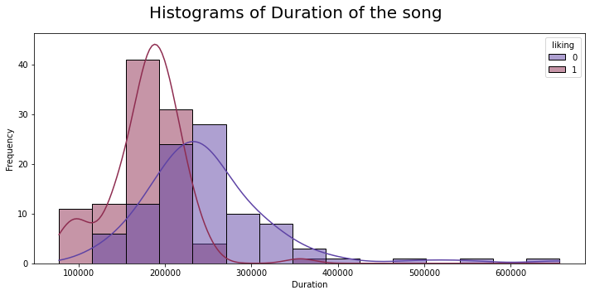
Histograms (cont.)
- liked tracks (<3.5 min) are generally low in duration compared to disliked tracks (<4 min)
- disliked and liked tracks are positively skewed (skewed right)
plt.figure(figsize=(10,5))
plt.suptitle('Histograms of Duration of the song', fontsize = 20)
ax1 = sns.histplot(x = data['duration_ms'],color= 'yellow', hue= data['liking'], bins= 15, kde= True, palette= 'twilight')
ax1.set(xlabel= 'Duration', ylabel= 'Frequency')
plt.tight_layout()
plt.show()

Slide 27

Histograms (cont.)
- liked tracks are generally higher in valence compared to disliked tracks
- disliked tracks vary in valence from low to high and cannot be generalized
- disliked tracks have a bimodal distribution (two peaks) while liked tracks, are slighly negatively skewed (skewed left)
plt.figure(figsize=(10,5))
plt.suptitle('Histograms of Valence', fontsize = 20)
ax1 = sns.histplot(x = data['valence'],color= 'yellow', hue= data['liking'], bins= 15, kde= True, palette= 'RdBu')
ax1.set(xlabel= 'Valence', ylabel= 'Frequency')
plt.tight_layout()
plt.show()

Slide 28


Pairplots
Liked Tracks
Disliked Tracks

Slide 29



Bar Graphs

Slide 30


Bar Graphs

Slide 31
Summary - Conclusions
Based on the EDA, we can say that the features posing high importance for Tom are:
Highly danceable
highly energetic
loudness
high in tempo
lower than 300,000 ms or 5 min in duration
mood of the song, generally happier ones(valence)
Link to the greatest playlist ;)
https://open.spotify.com/playlist/70CQj2Fu063UNJBQCI5IIW?si=28f208b89f634018

